Slide 1
Health Data for Florida
Peter S. Meyer, CDR, USPHS
Director, Research Data Center
Assistant Director, Office of Research and Methodology
National Center for Health Statistics
University of Louisiana
July 26, 2016
National Center for Health Statistics
Research Data Center

Slide 2
Department of Health and Human Services: National Center for Health Statistics
The National Center for Health Statistics (NCHS) monitors the Nation’s health by collecting, analyzing and disseminating health data to:
Compare across time, populations, providers and geographic areas.
Identify health problems, risk factors, and disease patterns.
Inform actions and policies to improve the health of the American people.

Slide 3
Major NCHS Surveys & Data Collections

Slide 4
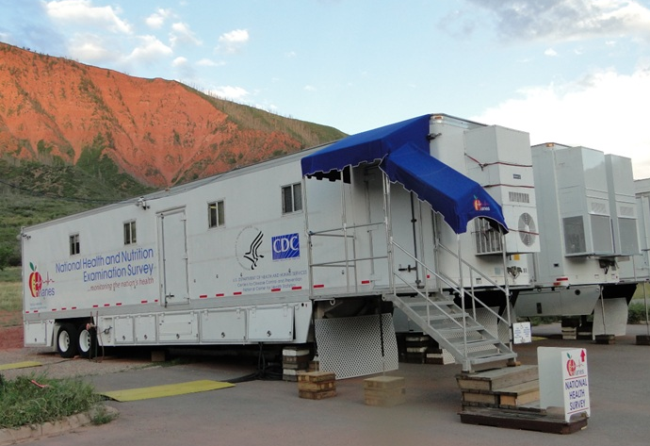
National Health and Nutrition Examination Survey
Standardized physical examinations, laboratory tests, personal interviews with a nationally representative annual sample of ~5,000 persons.
Data on:
Disease/condition prevalence
Nutrition
Body measures
Growth and development
Health-related behaviors
Risk factors
Notes:
The National Health and Nutrition Examination Survey (NHANES) is a program of studies designed to assess the health and nutritional status of adults and children in the United States. The survey is unique in that it combines interviews and physical examinations. Each year, the survey examines a nationally representative sample of about 5,000 persons located in 15 counties across the country. Findings from this survey will be used to determine the prevalence of major diseases and risk factors for diseases. Information will be used to assess nutritional status and its association with health promotion and disease prevention. NHANES findings also produce national references for such measurements as height, weight, and blood pressure. Data from this survey will be used in health sciences research and help develop sound public health policy, direct and design health programs and services, and expand the health knowledge for the Nation.

Slide 5
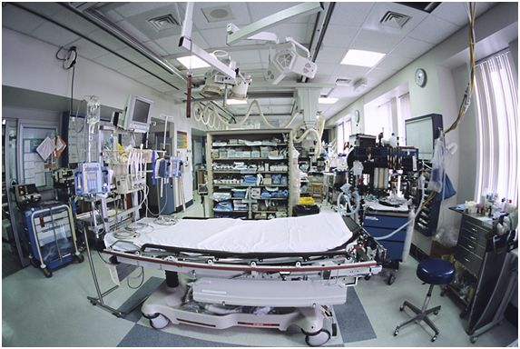
National Health Care Surveys
Ambulatory and hospital care surveys
National Ambulatory Medical Care Survey (NAMCS)
Physician offices
Community Health Centers
National Hospital Ambulatory Medical Care Survey (NHAMCS)
Outpatient Clinics
Emergency rooms
National Hospital Care Survey (NHCS)
Inpatient care -- hospitals
Long-term care surveys
National Study of Long-Term Care Providers (NSLTCP)
Administrative data: home health agencies, nursing homes, hospices
Questionnaire data: adult day services centers, residential care communities
Notes:
These are the National Health Care Surveys. The National Ambualtory Medical Care Survey collects data on physician offices and Community Health Centers and the care provided in those settings. The National Hospital Ambulatory Care Survey collects data on hospital outpatient departments, emergency departments and ambulatory surgery centers and free-standing ambulatory surgery Centers. The National Hospital Discharge Survey collects data on inpatient discharges from hospitals. The National hospital Discharge Survey is being replaced with the National Hospital Care Survey. The New National Hospital Care survey combines the NHAMCS and NHDS.
To complete our portfolio of health care surveys, in 2012 NCHS launched a new National Study of Long-Term Care Providers (NSLTCP). NSLTCP will replace the previously conducted National Nursing Home Survey, National Home and Hospice Care Survey, and most recently, National Survey of Residential Care Facilities.

Slide 6
NCHS Health Care Data
Characteristics of the practice
Characteristics of health care providers
Characteristics of patients
Diagnosis
Treatment and services
Patterns of disease
Use of technology and drugs
Notes:
These are the kinds of data collected by our surveys – data on the practice – sources of revenue, characteristics of the ownership and staffing, practice size and the presence of electronic health records.
We collect data about the clinicians, their specialty , demographics and other characteristics
For patients we collect data on their demographics, medical conditions, insurance status, vital signs residential zip code.
And data about the encounter including the reason for the visit, the diagnosis. Services ordered or provided, counseling or medications ordered and provided visit duration and disposition.

Slide 7
National Health Interview Survey
In person, in home survey collects data on about 87,500 persons in 35,000 responding households per year.*
Representative of the noninstitutionalized civilian U.S. population.
Data on:
Health status, health conditions, functioning and disability
Insurance coverage
Access to and use of health services
Immunization
Health-related behaviors and risk factors
Special topics
* Usual sample size. PPHF supported expansion of 2013 sample size to approximately 41,300 households.
Notes:
The National Health Interview Survey (NHIS) is the principal source of information on the health of the civilian noninstitutionalized population of the United States. The NHIS is a cross-sectional household interview survey. Sampling and interviewing are continuous throughout each year. In the past, the expected NHIS sample size (completed interviews) has been approximately 35,000 households containing about 87,500 persons. Funding from the Prevention and Public Health Fund has allowed the NHIS sample to expand to about 42,000 households with approximately 108,000 persons.
NHIS data are used widely throughout the Department of Health and Human Services (DHHS) to monitor trends in illness and disability and to track progress toward achieving national health objectives. The data are also used by the public health research community for epidemiologic and policy analysis of such timely issues as characterizing those with various health problems, determining barriers to accessing and using appropriate health care, and evaluating Federal health programs.

Slide 8
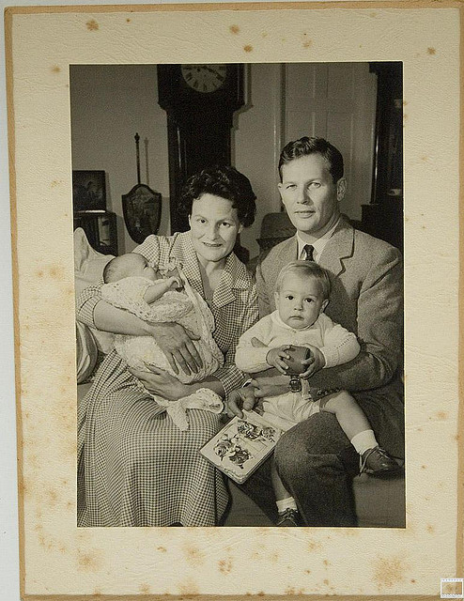
National Survey of Family Growth
In-person interview with men and women 15-44 years of age, representative of the noninstitutionalized civilian U.S. population
Data on
Reproductive health
Fertility/infertility
Contraception
Pregnancy
Sexual activity
Family formation
Marriage, divorce, cohabitation

Slide 9
National Vital Statistics System
Data received from 57 vital registration jurisdictions (50 states, DC, NYC, 5 territories).
Births and information on the pregnancy and delivery.
Deaths and information on cause of death.
Produces state and local level data.
Notes:
The National Vital Statistics System is the oldest and most successful example of inter-governmental data sharing in Public Health and the shared relationships, standards, and procedures form the mechanism by which NCHS collects and disseminates the Nation's official vital statistics. These data are provided through contracts between NCHS and vital registration systems operated in the various jurisdictions legally responsible for the registration of vital events – births, deaths, and fetal deaths. In the United States, legal authority for the registration of these events resides individually with the 50 States, 2 cities (Washington, DC, and New York City), and 5 territories (Puerto Rico, the Virgin Islands, Guam, American Samoa, and the Commonwealth of the Northern Mariana Islands).

Slide 10
NCHS Data Linkage
Linked data enable broader analyses of factors that influence health and health outcomes
Surveys are linked with administrative data such as
The National Death Index
Claims data from the Centers from Medicare & Medicaid Services
Supplemental Security Income data from the Social Security Administration
Linked data are accessed through
Public-use files
NCHS Research Data Center (for restricted use files)

Slide 11
NCHS Data Access and Resources

Slide 12
Types of Data and Data Access http://www.cdc.gov/nchs/data_access.htm
Public
Data files: collapsed categories, top and bottom coded
Reports
Restricted: Direct Identifiers
Name, SSN, address
Used to create the Linkage Products and removed
Never available
Restricted: Indirect Identifiers
Items that when combined with other information (from NCHS or other sources) could lead to identification
Geography, dates, detailed race/ethnicity, occupation, genetic data
Available through the RDC
Notes:
Any identifiable characteristic such as extreme height, weight or age has been hidden by collapsing categories or top and bottom coding
Reports = NHSR, series reports, data briefs, QuickStats (MMWR)

Slide 13
Research Data Center http://www.cdc.gov/rdc/
Provides a mechanism for researchers to access data not released to the public because of nondisclosure or confidentiality reasons
Small area or micro data
Matches/ links to external data files
Access is provided either on site or via a remote system
Notes:
NCHS developed the Research Data Centers (RDC) to allow researchers access to data that cannot be released publicly to protect respondent confidentiality. This restricted data could lead to a breach of our agreement with the respondent to preserve their anonymity and the confidentiality of their information. Access is available on site at the RDCs in Hyattsville, Atlanta, and the 17 Census RDCs, as well as through a remote system. Today, in addition to providing access to NCHS data, the RDC also hosts restricted data from a variety of groups within HHS.

Slide 14
Legalities
Public Health Service Act, 1956 (Sec. 308)
“…NCHS shall publish, make available, and disseminate [health] statistics on as wide a basis as is practicable.”
“No information if…it is identifiable…may not be published or released.”
Confidential Information Protection and Statistical Efficiency Act (CIPSEA)
“Whoever…willfully discloses the information…shall be guilty of a class E felony and imprisoned for not more than 5 years, or fined not more than $250,000, or both.

Slide 15
Reasons to Use Restricted Data
To combine datasets
To use as selection criteria for a study
To access the continuous version of a categorical variable
To answer your main research question
To control for confounders/examine effect modifiers
To make accurate estimates, you may need restricted information about the sampling frame

Slide 16
The Research Data Center
Role
The RDC system was created to provide a secure environment for researchers to access restricted data in order to answer important public health questions
Answers leave the RDC – not individual data
How we protect restricted data
Require a research proposal
Limit access to specific modes of access
Confidentiality training and paperwork
Review output

Slide 17
The Proposal: Its Purpose
Identify a need for restricted data
Identify public health benefit
Assess disclosure risk
Determine mode of access
Determine software needs

Slide 18
Proposal Review Process
Review Committee
Reviews it for disclosure (not scientific merit)
RDC analyst
Data representative
NCHS Confidentiality officer
RDC Director
Iterative Process
The review process tends to be back-and-forth where we work together to determine exactly what you need to answer the question without compromising confidentiality

Slide 19
Modes of Access
NCHS RDC
Two locations: Hyattsville, MD and Atlanta, GA
Secure room with non-networked computers where researchers can work
Remote Access System (ANDRE)
Researchers submit code form their PC to a remote system which authenticates the user, runs the code, checks for disclosure, suppresses necessary output, and returns it to the researcher
Staff Assisted
Staff runs programs for the researcher
Census RDCs
Similar set up to the NCHS RDCs, but expands our reach to more than a dozen research institutions across the country

Slide 20
Confidentiality Training and Paperwork
Online Confidentiality Training
Reviews the importance of confidentiality
Outlines logistics of do’s and don’ts when accessing restricted data
Explains the output review process
Designated Agent Forms
Puts the responsibility on the researcher to prevent disclosure
Legally binding

Slide 21
Output Review: General Output Policies
When output is ready for publication, the researcher submits output to be reviewed
RDC staff review the output and return approved output to the researcher via email
Absolutely NO individual level data will leave the RDC facilities
Output must match the research question/output suggested in the proposal
We recommend that output emphasize model output rather than tabular output
We recommend that researchers avoid intermediate output (output that will not appear in publication)
This output can certainly be created and used in the RDC, but we discourage its release

Slide 22
Data Systems Available at the RDC

Slide 23
NCHS Surveys and Data Systems Available Through the RDC
National Health and Nutrition Examination Survey (NHANES) http://www.cdc.gov/nchs/nhanes.htm
National Health Care Surveys http://www.cdc.gov/nchs/dhcs.htm
National Health Interview Survey (NHIS) http://www.cdc.gov/nchs/nhis.htm
National Immunization Survey (NIS) http://www.cdc.gov/nchs/nis.htm
National Survey of Family Growth (NSFG) http://www.cdc.gov/nchs/nsfg.htm

Slide 24
NCHS Surveys and Data Systems Available Through the RDC (con’t)
National Vital Statistics System (NVSS) http://www.cdc.gov/nchs/nvss.htm
State and Local Area Integrated Telephone Survey (SLAITS) http://www.cdc.gov/nchs/slaits.htm
Linked Data Products http://www.cdc.gov/nchs/data_access/data_linkage_activities.htm
Data Hosting
CDC’s National Assisted Reproductive Technology (ART) Surveillance Data
National Program of Cancer Registries

Slide 25
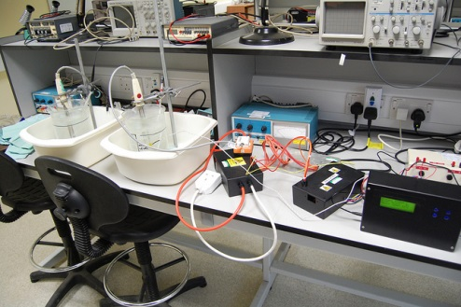
NHANES
Program of studies designed to assess the health and nutritional status of adults and children in the U.S.
Components
Demographic data
Dietary data
Physical exam data
Lab data
Examples of health conditions and risk factors studied
Diabetes, osteoporosis, anemia, reproductive history, cardiovascular disease, infectious disease, sexually transmitted disease
Smoking, alcohol consumption, sexual practices/behavior, drug use, physical fitness and activity, environmental exposures, dietary intake

Slide 26
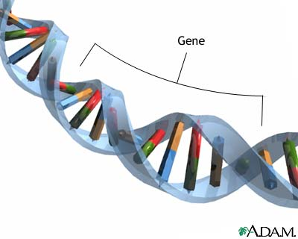
NHANES Restricted Variables
Geography
Youth Variables
Psychological conditions
Chlamydia/gonorrhea/herpes II
Youth conduct disorder
Alcohol use, smoking, sexual behavior, reproductive health, and drug use
Genetic Data: NHANES III and Continuous NHANES
Linked Files: Mortality, CMS, and SSA

Slide 27
Health Care Surveys
National Ambulatory Medical Care Survey (NAMCS): Physician-reported
Topics
Patient demographics
Symptoms
Diagnostic tests
Diagnosis
Treatment
Medication
Screening
Payment
Length of stay
National Hospital Ambulatory Medical Care Survey (NHAMCS): Hospital-reported
National Hospital Discharge Survey (NHDS): Patient records
Restricted Variables
Physician characteristics
Geography
Education/income of local population

Slide 28
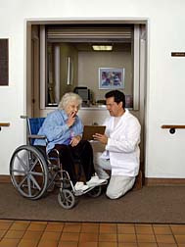
Health Care Surveys: Long Term Care
National Nursing Home Survey (NNHS)
Long-term care drug database
Facility data: size, ownership, Medicare/Medicaid certification, services provided and specialty programs offered, and charges
Patient data: demographic characteristics, health status, medications taken, services received, and sources of payment
National Nursing Assistant Survey (NNAS)
Designed to help industry more effectively recruit, train, and retain nursing assistants

Slide 29
NHIS
Designed to monitor the health of the U.S. population through the collection and analysis of data on a broad range of health topics
Core Questionnaire Components
Household
Family
Sample Adult
Sample Child
Supplemental Questionnaires
Changes depending on data needs
Examples include Cancer Screening, Complementary and Alternative Medicine, Children’s Mental Health, and Healthcare Utilization

Slide 30
NHIS Restricted Variables
Country of birth
State of birth
Year of birth
More detailed race/ethnicity
Industry and occupation codes
Detailed income
Linked Files: Mortality, CMS, and SSA

Slide 31
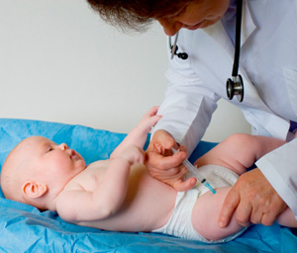
NIS
Data collection began in April 1994 to monitor childhood immunization coverage
The target population is children age 19-35 months living in the U.S. at the time of the interview
Data are used to produce timely estimates of vaccination coverage for all childhood vaccinations recommended by the Advisory Committee on Immunization Practices (ACIP)
Restricted Variables
Geography

Slide 32
NSFG
Was initially designed to be the national fertility survey of the U.S., focusing on factors that help explain trends and group differences in birth rates
Topics Studied
Marriage
Divorce
Contraception
Pregnancy
Sexual activity
Sexually transmitted infections

Slide 33
NSFG Components
Female Respondent Data File (public use)
Male Respondent Data File (public use)
Female Pregnancy Data File (public use)
ACASI Data (special request)
Comprehensive description of current and past behavior related to the risk of acquiring STIs
Information about oral and anal sex and same-sex partners
Interviewer Data (RDC)
Notes from the interviewer that can help assess issues related to data quality
Contextual Data (RDC)
Geography
Proportion of racial/ethnic groups, age, income, etc. by geography

Slide 34
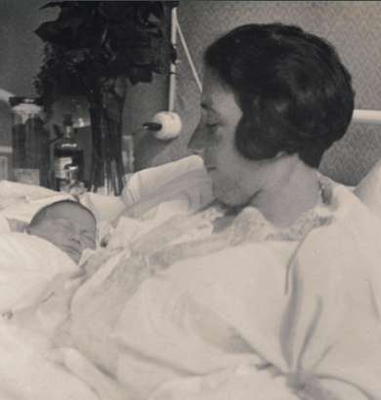
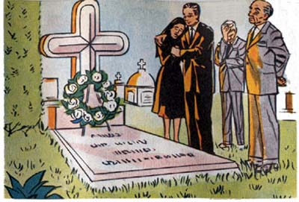
NVSS
Birth, death, marriage, divorce, and fetal death data are provided through contracts between NCHS and vital registration systems legally responsible for the registration of these events
Restricted Variables
Exact dates of vital events
Geography

Slide 35
SLAITS
National Survey of Children’s Health (NSCH) (2003-2007)
National Survey of Children with Special Health Care Needs (NSCSHCN) (2001,2005-2006, 2009-2010)
National Survey of Adoptive Parents (NSAP) (2007)
National Survey of Adoptive Parents of Children with Special Health Care Needs (NSAP-SN) (2008)
Restricted Variables
Link between NSCH and NSAP
Link between NSCSHCN and NSAP-SN
Geography
Detailed race/ethnicity
Income
Details about barriers to care
Height and weight
Acculturation

Slide 36
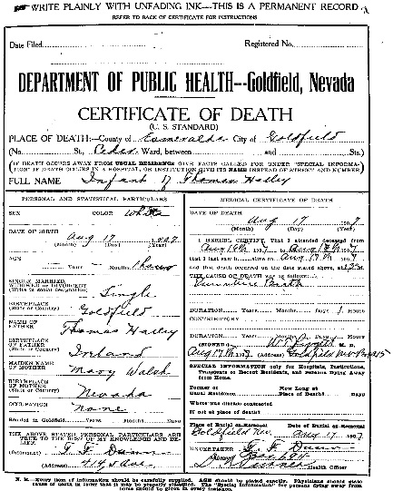
Linked Data Products
Mortality data has been linked to
NHIS 1985-2009
NHANES II, III, 1999-2010
NHANES I Epidemiologic Follow-Up Study
SOA, LSOA II
NNHS 1985, 1995, 1997, 2004
NHHCS 2007
Kolkaata
Medicare/Medicaid (CMS) data has been linked to
NHIS 1994-2005
NHANES I, II, III, 1999-2004
NHANES I Epidemiologic Follow-Up Study
LSOA II
NNHS 2004
Notes:
SOA = Supplement on Aging
LSOA = Longitudinal Study of Aging
NNHS = National Nursing Home Survey
NHHCS = National Home and Hospice Care Survey
The linkage branch is currently updating the Medicare/Medicaid linkage and hope to have it available later this year

Slide 37
Linked Data Products
Retirement and Disability (SSA) data has been linked to
NHIS 1994-2005
NHANES III, 1999-2004
NHANES I Epidemiologic Follow-Up Study
LSOA II
NNHS 1985, 1995, 1997, 2004

Slide 38
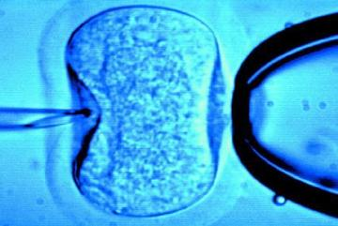
National ART Surveillance System
Assisted Reproductive Technology (ART)
Web-base reporting system which collects information on all ART cycles started in the U.S.
Data collected includes
Patient characteristics
ART procedure information
Treatment outcomes
Data are sensitive and contain personal medical information about women undergoing ART and infants born after ART
RDC hosts limited, de-identified NASS datasets for cycles initiated during or after 2004

Slide 39
National Program of Cancer Registries
Population-based surveillance system of cancer registries which collects data on cancer for 96% of the U.S.
NPCR Restricted Access File
Includes demographics, cancer identification data, and stage/prognosis factors
Comparative Effectiveness Research (CER) Data
Includes treatment and biomarker data for 2011 breast, colon, and rectal cancers and chronic myeloid leukemia cases collected from ten geographically diverse registries

Slide 40
Concluding Thoughts
Some data cannot be released publicly
The RDC provides a safe place for important research that requires access to restricted data to be completed
Together our policies and procedures (proposal process, limited access, confidentiality training and paperwork, and output review) provide layers of security to our data
Combining health data with other sources of data (policy, contextual, economic, environmental, and administrative) can expand the utility of data without additional data collection and often with reduced costs

Slide 41
Questions

