Slide 1
Research Opportunities at Federal Statistical Research Data Centers
Shawn D. Klimek, Director of Research
Center for Economic Studies
U.S. Census Bureau

Slide 2
Goal (and Agenda)
Inform potential users and stakeholders about:
Federal Statistical Research Data Center (FSRDC) Program
Accessing Data
U.S. Census Bureau
National Center for Health Statistics (NCHS)
Bureau of Labor Statistics (BLS)

Slide 3
Homework?
Prospective researchers in the coming weeks and months should be developing proposals to use the data available in the FSRDCs in support of a grant application to the National Science Foundation in 2016.

Slide 4
History of the FSRDC Program
Census Bureau wanted to increase access to business data, started at HQ in mid-1980’s
Expanded access through remote RDCs in Boston and Carnegie Mellon University in mid-1990’s
Partnership with NSF in 1998
Agreements with other agencies (AHRQ and NCHS) in mid-2000’s to use the RDCs
Agreement with BLS signed in 2016

Slide 5
Current Status of the FSRDCs
January 2015: Interagency Council on Statistical Policy (ICSP) approves rebranding of Census RDCs to Federal Statistical RDCs
February 2015: new website for the program is launched
AHRQ, NCHS, and Census make their data available to approved researchers
Currently: there are 24 FSRDCs
2016/2017: 6 additional locations expected to open

Slide 6
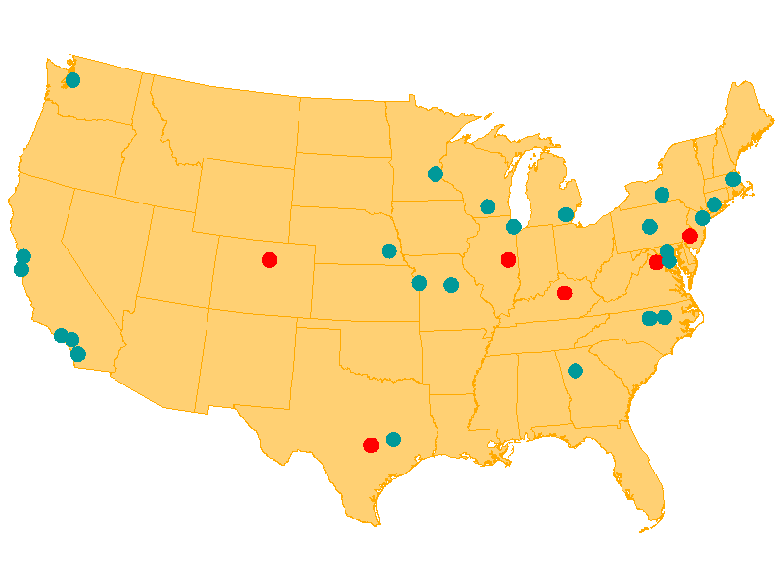
Current FSRDC Program

Slide 7
ICSP Members
Bureau of Economic Analysis
Economic Research Service*
U.S. Census Bureau*
National Center for Health Statistics*
Bureau of Labor Statistics*
Bureau of Justice Statistics*
National Center for Science and Engineering Statistics*
National Center for Education Statistics*
Office of Management and Budget
Energy Information Agency*
Social Security Administration*
National Agricultural Statistics Service
Bureau of Transportation Statistics*
Statistics of Income*

Slide 8
Operations and Oversight
Census
Lead role in the operations and coordination
Legal agreements
Points of Contact for partner agencies
AHRQ – Rachelle Hill
NCHS – Angela Andrus
BLS – TBD
Governance structure in development
Office of Management and Budget and Census leading team

Slide 9
Role of FSRDC Program
To facilitate
research
for a statistical purpose.
Increase access to a wide variety of micro data
Improve utility and quality of federal statistics
Address policy questions

Slide 10
FSRDC Data Protections
Confidentiality
Title 13 (Census), Title 15 (NCHS) and Title 26 (IRS) U.S. Code
Privacy Act
Confidential Information Protection Statistical Efficiency Act (CIPSEA)
Census Special Sworn Status (oath for life)
Substantial penalties for violation

Slide 11
Projects by Agency

Slide 12
Administrative Records Clearinghouse (FY2016)
Expedites acquisition of Federal and Federally-sponsored administrative data sources, improves data documentation, and maintains privacy protection and secure access to these data sources Confidential Information Protection Statistical Efficiency Act (CIPSEA)
Promotes the Federal Statistical System’s mission of providing quality, unbiased data to support reasoned, disciplined decisions including enabling higher-quality Federal program evaluations.
Supports the Department of Commerce’s Data goal and objective 4.2 to “Improve data-based services, decision-making, and data sharing within the Department and within other parts of the Federal Government.”

